Slide 1
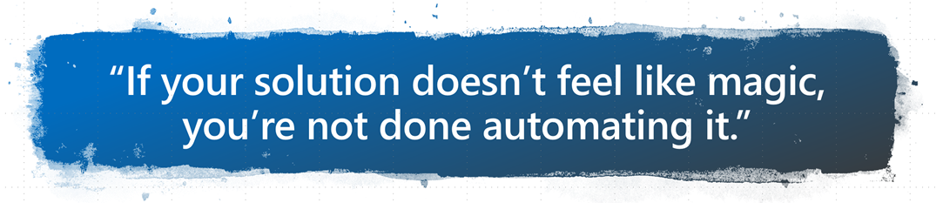
DevOPS for Office365DSC
Keeping Multiple Tenants in Sync
Nik Charlebois – Senior Premier Field Engineer

Slide 2
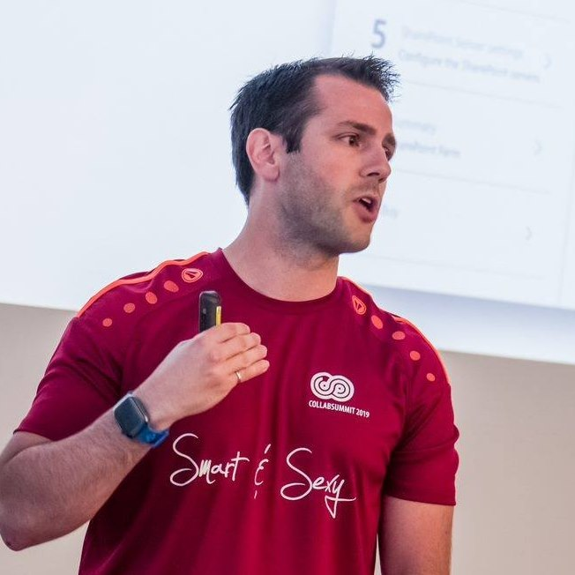
Meet ‏@NikCharlebois
Microsoft Senior Premier Field Engineer
Focusing on SharePoint Development and Automation
Overall DSC goodness evangelist
About Me
Ex-PowerShell MVP
Author of the books Beginning PowerShell for SharePoint 2013 and 2016 & Office 365 Experts
Based in Gatineau, Quebec
Speaker at various technology conference
Blogger at http://NikCharlebois.com
Co-Owner of SharePointDSC and Owner of ReverseDSC & Office365DSC

Slide 3
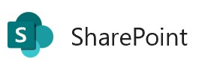
Managing Expectations
Kind of a……Very technical session
We’ll take about 15 minutes to do an introduction to DSC;
Please ask your questions as we go;

Slide 4
Agenda
Overview of PowerShell DSC;
ReverseDSC in action;
Introduction to Office365DSC;
Azure DevOPS & Integration scenarios for Office 365;

Slide 5
Desired State Configuration

Slide 6
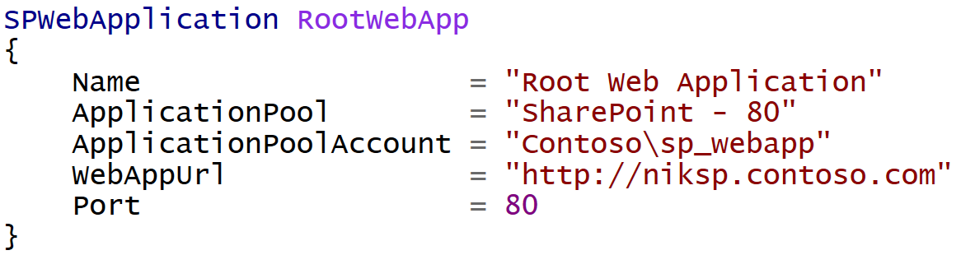
Difference with Classic PowerShell
It’s a Declarative approach;
Notes:
Meaning I don’t tell it do this and then that, but rather here is how I want this, then do whatever in you need to to get me there

Slide 7
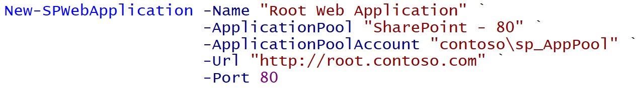
Imperative
Declarative
Notes:
Same result. Yes more lines in this example, but ensures it stays in that state.

Slide 8

PowerShell DSC (10,000 feet overview)
Deployment Automation and monitoring solution;
Ensures that environments stay in their Desired State;
PowerShell 4.0 and above (therefore no support for SP2010);

Slide 9
Monitoring Configuration Drifts
Configuration Modes:
ApplyOnly
ApplyAndMonitor
ApplyAndAutoCorrect

Slide 10
Monitoring Configuration Drifts
Configuration Modes:
ApplyOnly
ApplyAndMonitor
ApplyAndAutoCorrect
Configure server as specified, then done.;
Equivalent to using sequential scripts (or AutoSPInstaller).

Slide 11
Monitoring Configuration Drifts
Configuration Modes:
ApplyOnly
ApplyAndMonitor
ApplyAndAutoCorrect
Monitors Configuration Drifts;
Logs drifts in Event Viewer;

Slide 12
Monitoring Configuration Drifts
Configuration Modes:
ApplyOnly
ApplyAndMonitor
ApplyAndAutoCorrect
Monitors Configuration Drifts;
Automatically fixes drifts.

Slide 13
Ensure
DSC is not only about making sure that certain components are configured on a sever;
Every resource has a parameter Ensure exposed;
Setting Ensure = Absent makes sure that the specified component is NEVER configured on the server;
Hard to define all “non-config” scenarios….it’s actually impossible;
SPServiceInstance SearchAdmin
{
Name = "WSSSearch"
Ensure = "Absent"
}

Slide 14

DSC Modules
Macro components that extend the reach of DSC (e.g. SharePointDSC, SQLServerDSC, etc.)
All available on the PowerShell Gallery (http://PowerShellGallery.com)

Slide 15
Demo 1
Managed Paths with DSC

Slide 16
ReverseDSC

Slide 17
Internal Logic of DSC Resources
Test – » Am I in my Desired State ?
Get – » How am I currently configured?
Set – » Bring me into my Desired State!

Slide 18
ApplyAndAutocorrect Flow

Slide 19

ReverseDSC
Extract DSC Configuration from existing environments.
Framework that requires a technology specific Orchestrator to operate..
ReverseDSC Orchestrator for SharePoint is available on the PowerShell Gallery;
Install-Script SharePointDSC.Reverse

Slide 20
ReverseDSC Scenarios
Recreating an environment for Troubleshooting;
Point-in-time snapshot;
Delta Analysis;
Disaster Recovery;
On-boarding existing environment onto DSC for monitoring;
Keeping environments in-sync;

Slide 21
Demo 2
ReverseDSC for SharePoint

Slide 22
Office365DSC

Slide 23







Office365DSC
Will support all Office 365 Workloads:
PowerApps
Flow […]
Still in the early development phases
Aka.ms/Office365DSC

Slide 24
Office365DSC
Visit wiki for details on current workloads
Aka.ms/Office365DSCWiki

Slide 25

Office365DSC
Create new site collections, new Teams & Channels, manage groups, users and licenses, etc.
Allows for integration between Office 365 Configs and Azure DevOPS;
Makes it easy to configure multiple tenants the same;

Slide 26
Office365DSC
Help wanted
Testing
Development
Suggestions and ideas
Please visit Github site
Aka.ms/Office365DSC

Slide 27
Demo 3
Teams Deployment

Slide 28
Demo 4
Tenants Synchronization

Slide 29
Azure Automation

Slide 30


Pull Server
Central server that stores all configurations for your enterprise (e.g. WFE, SQLServer, DC, etc.)c
Pull Server

Slide 31
Pull Server
Central server that stores all configurations for your enterprise (e.g. WFE, SQLServer, DC, etc.)
Pull Server

Slide 32

Overview of AADSC
Pull Server as a Service;
Included as part of an Azure Automation Account;
Free when used with Azure VMs;

Slide 33

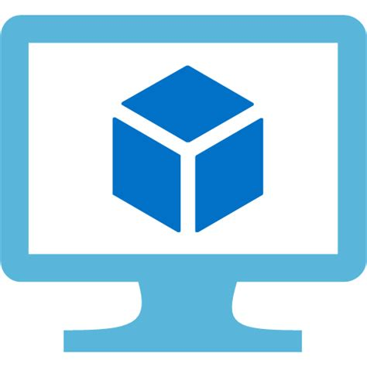

Overview of AADSC[…]
Azure Virtual Machine
DSC Script
Azure Automation

Slide 34
Demo 5
Azure Automation - Firewall Rule

Slide 35
Demo 6
Azure Automation for Office 365 Monitoring

Slide 36
Azure DevOPS

Slide 37

Azure DevOPS
Manage your Office 365 configuration as code;
Automate deployments upon configuration changes;
DevOPS at its best!
Challenge is to convince IT Pros to use it.

Slide 38
Demo 7
Azure DevOPS for Office 365

Slide 39
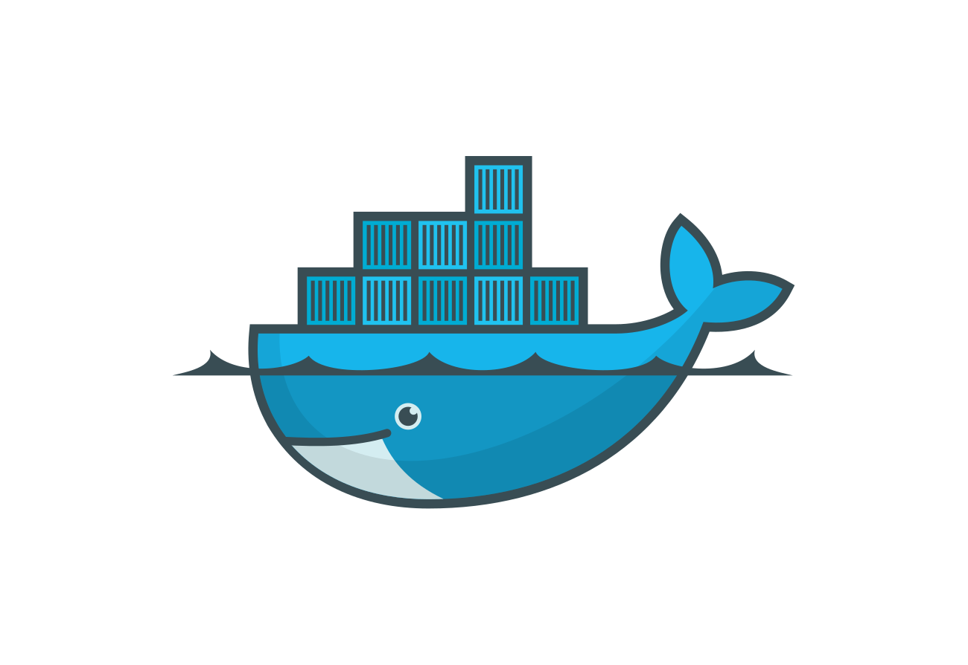

SaaS Paradigm
Effet Middle-Man;
Azure DevOPS Build Agent;
Azure Container Instance;
Azure Jobs & Batch;
LCM-as-a-Service

Slide 40
Questions

